Slide 1
Distributed Web-based systems
Prof. Orhan Gemikonakli
Module Leader: Prof. Leonardo Mostarda
Università di Camerino

Slide 2
Last lecture
Distributed file systems
Architecture
Processes
Communication
Naming
Synchronization
Consistency and Replication
Fault Tolerance

Slide 3
Outline
Distributed Web-based systems
Architecture
Processes
Communication
Naming
Synchronization
Consistency and Replication
Fault Tolerance
Tanenbaum & Van Steen, Distributed Systems: Principles and Paradigms, 2e, (c) 2007
Prentice-Hall, Inc. 0-13-239227-5

Slide 4
Learning outcomes
To understand the basic concepts related to distributed web-based systems
To describe and discuss
Architecture
Processes
Communication
Naming
Synchronization
Consistency and Replication
Fault Tolerance as they apply to distributed web-based systems

Slide 5
Distributed Web-based systems
WWW – a huge distributed system
Millions of clients and servers
Linked documents
Started as a project of the European Particle Physics Laboratory (CERN) in Geneva
A hypertext system for sharing documents.
GUIs became available
Mosaic
1994: WWW consortium of CERN + MIT
Standardisation, interoperability, enhancing capabilities
From a document system to services

Slide 6
Architecture
Traditional web-based systems
Static, passive documents
Client-server
Uniform Resource Locator (URL)
HyperText Transfer Protocol (HTTP). Browsers
Web documents:
HyperText Markup Language (HTML)
Extensible Markup Language (XML)
TAGs refer to embedded documents
Multipurpose Internet Mail Exchange (MIME): type of embedded document
Web services
Documents are dynamically generated

Slide 7
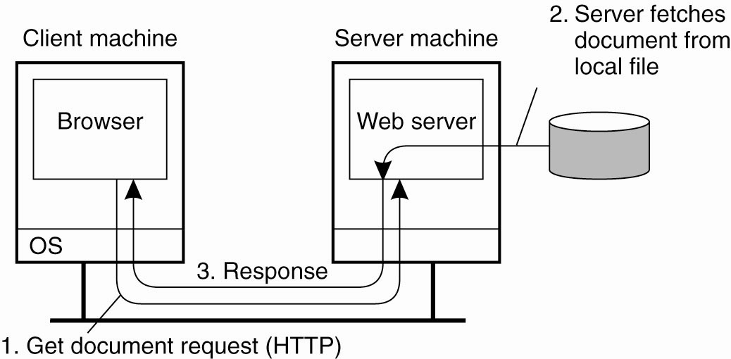
Traditional Web-Based Systems
Figure 12-1. The overall organization of a traditional Web site.

Slide 8
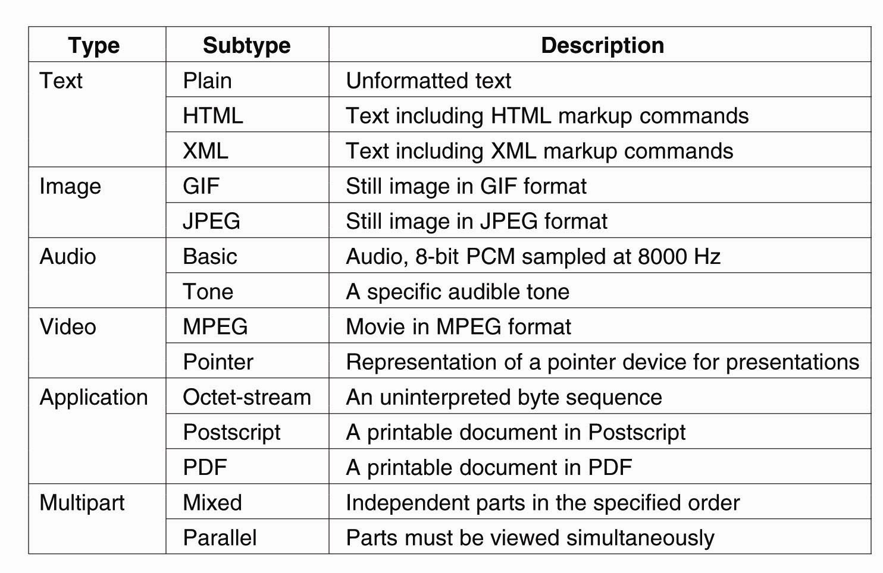
Web Documents
Figure 12-2. Six top-level MIME types and some common subtypes.

Slide 9
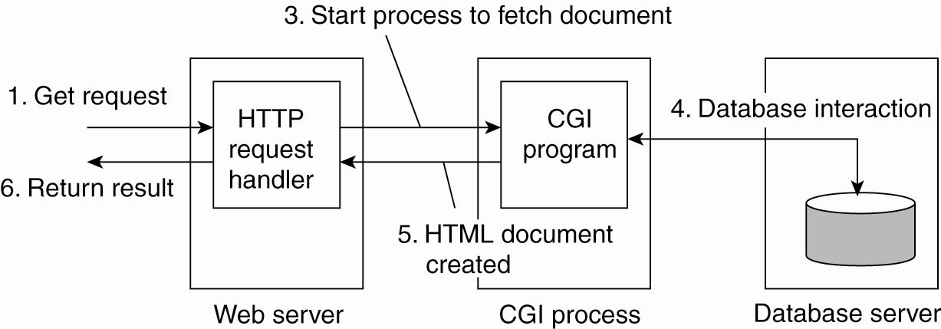
Multitiered Architectures
Figure 12-3. The principle of using server-side Common Gateway Interface (CGI) programs.
Performance degradation!

Slide 10
Architecture: Web Services
Mostly client-server architecture
General services to remote processes without a browser
Naming service, weather reporting service, electronic supplier etc.
A directory service storing service descriptions
Universal Description, Discovery and Integration (UDDI): A standard for the directory service
Web Services Definition Language (WSDL)
A formal language defining interfaces provide by services
Simple Object Access Protocol (SOAP)
Specification of how communication takes place for services

Slide 11
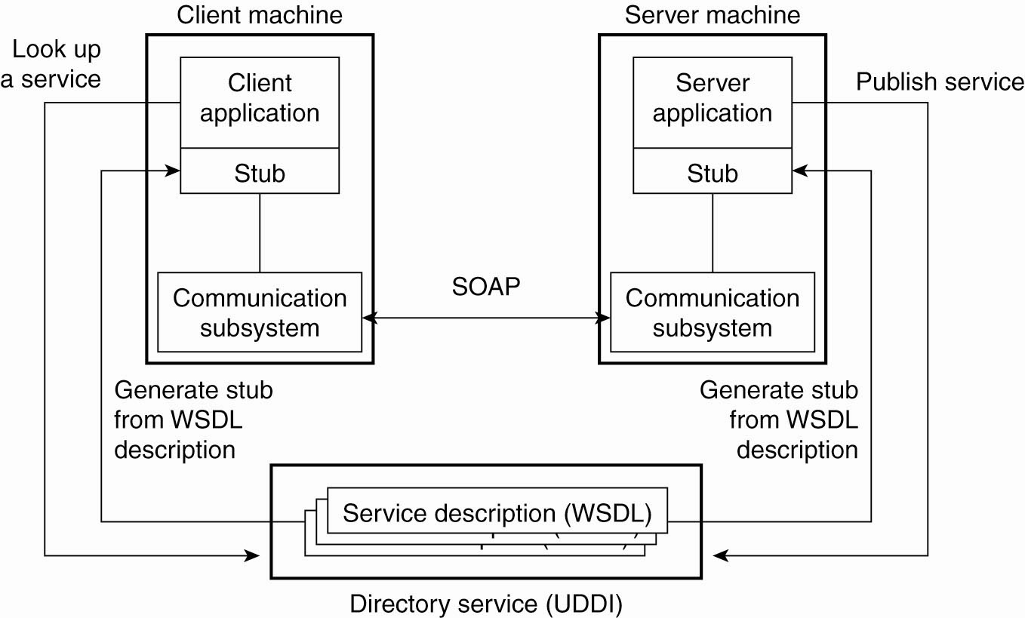
Web Services Fundamentals
Figure 12-4. The principle of a Web service.

Slide 12
Processes
Clients
Web browser – platform independent
User interface
|Browser engine – go over a document, select parts of it, activbate hyperlinks etc.
Rendering engine – contains all the code for properly displaying the document: Parsing HTML/XML, script interpretation
Plug-ins: An extension
Web Proxy
The Apache Web Server
Server Clusters

Slide 13
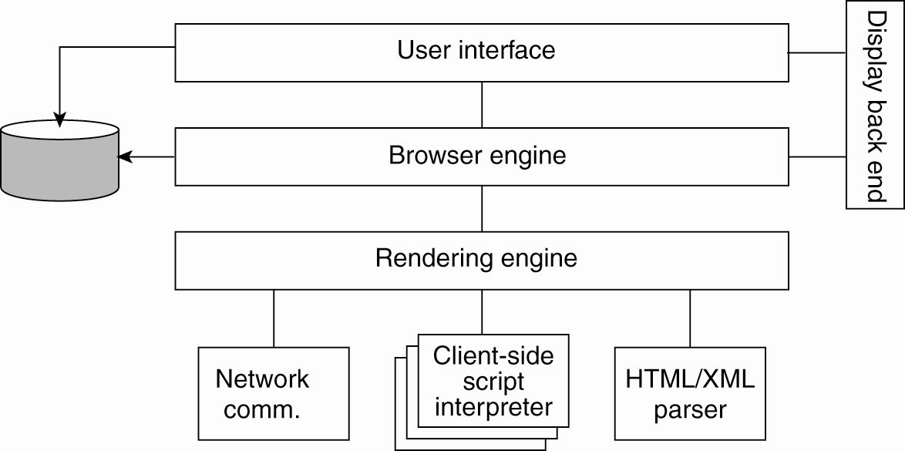
Processes – Clients (1)
Figure 12-5. The logical components of a Web browser.

Slide 14
Processes – Clients (2)
Figure 12-6. Using a Web proxy when the browser does not speak FTP.

Slide 15
The Apache Web Server
Popular: Hosts approx. 70% of websites
Completely general server
Reliable
Highly configurable
Extensible
Independent of specific platforms
Apache Portable Runtime (APR): runtime environment – a library that provides platform independent interface for file handling, networking, locking, threads, etc.
Hook: Placeholder for a group of specific functions
E.g. transfer URL to a local filename

Slide 16
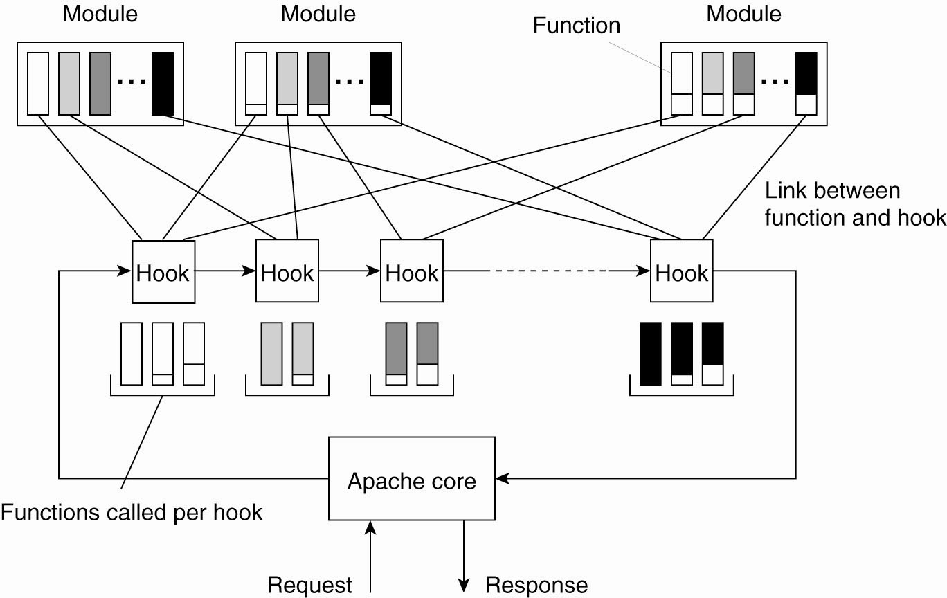
The Apache Web Server
Figure 12-7. The general organization of the Apache Web server.

Slide 17
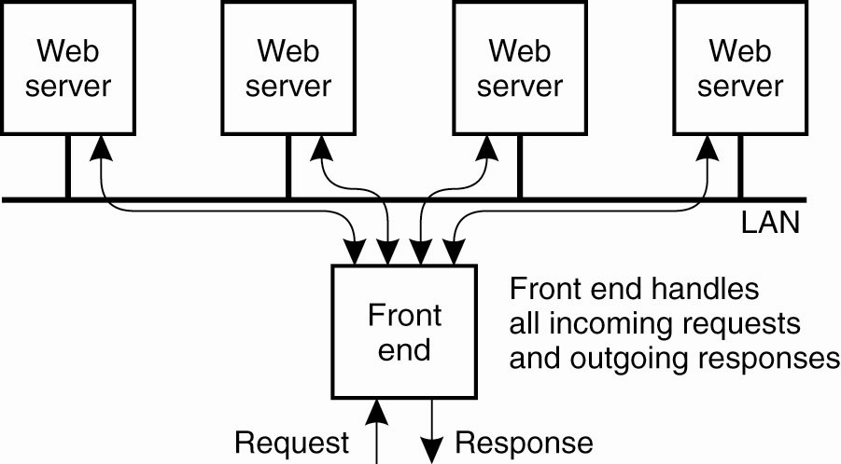
Web Server Clusters (1)
Figure 12-8. The principle of using a server cluster in combination with a front end to implement a Web service.

Slide 18
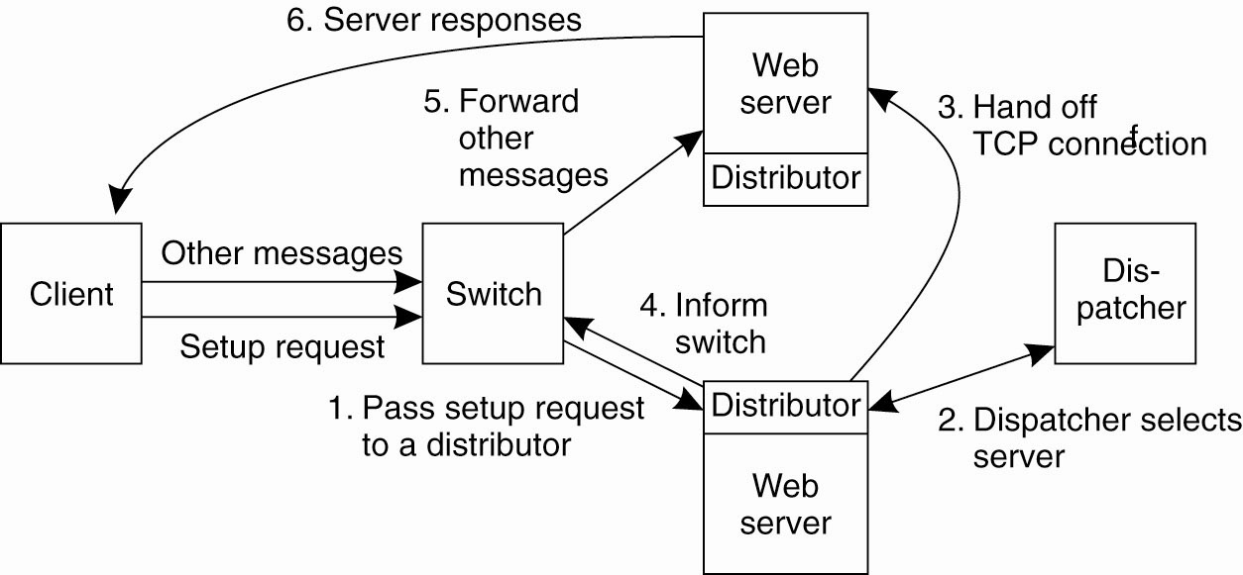
Web Server Clusters (2)
Figure 12-9. A scalable content-aware cluster of Web servers.

Slide 19
Communication
HyperText Transfer Protocol (HTTP)
A simple client-server protocol
Stateless
Connections
Persistent: client sets up e new connection for each request, server responds, connection breaks down
non-persistent: Several requests are responded to before breaking down the connection
Simple Object Access Protocol (SOAP)

Slide 20
HTTP Connections (1)
Figure 12-10. (a) Using nonpersistent connections.

Slide 21
HTTP Connections (2)
Figure 12-10. (b) Using persistent connections.

Slide 22
HTTP Methods
Figure 12-11. Operations supported by HTTP.

Slide 23
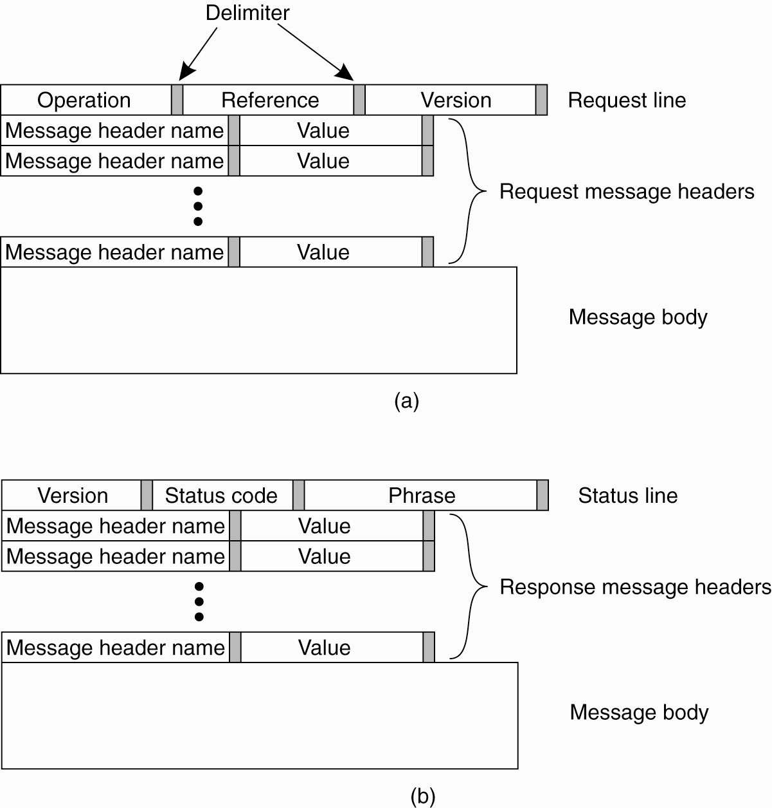
HTTP Messages (1)
Figure 12-12. (a) HTTP request message.

Slide 24
HTTP Messages (2)
Figure 12-12. (b) HTTP response message.

Slide 25
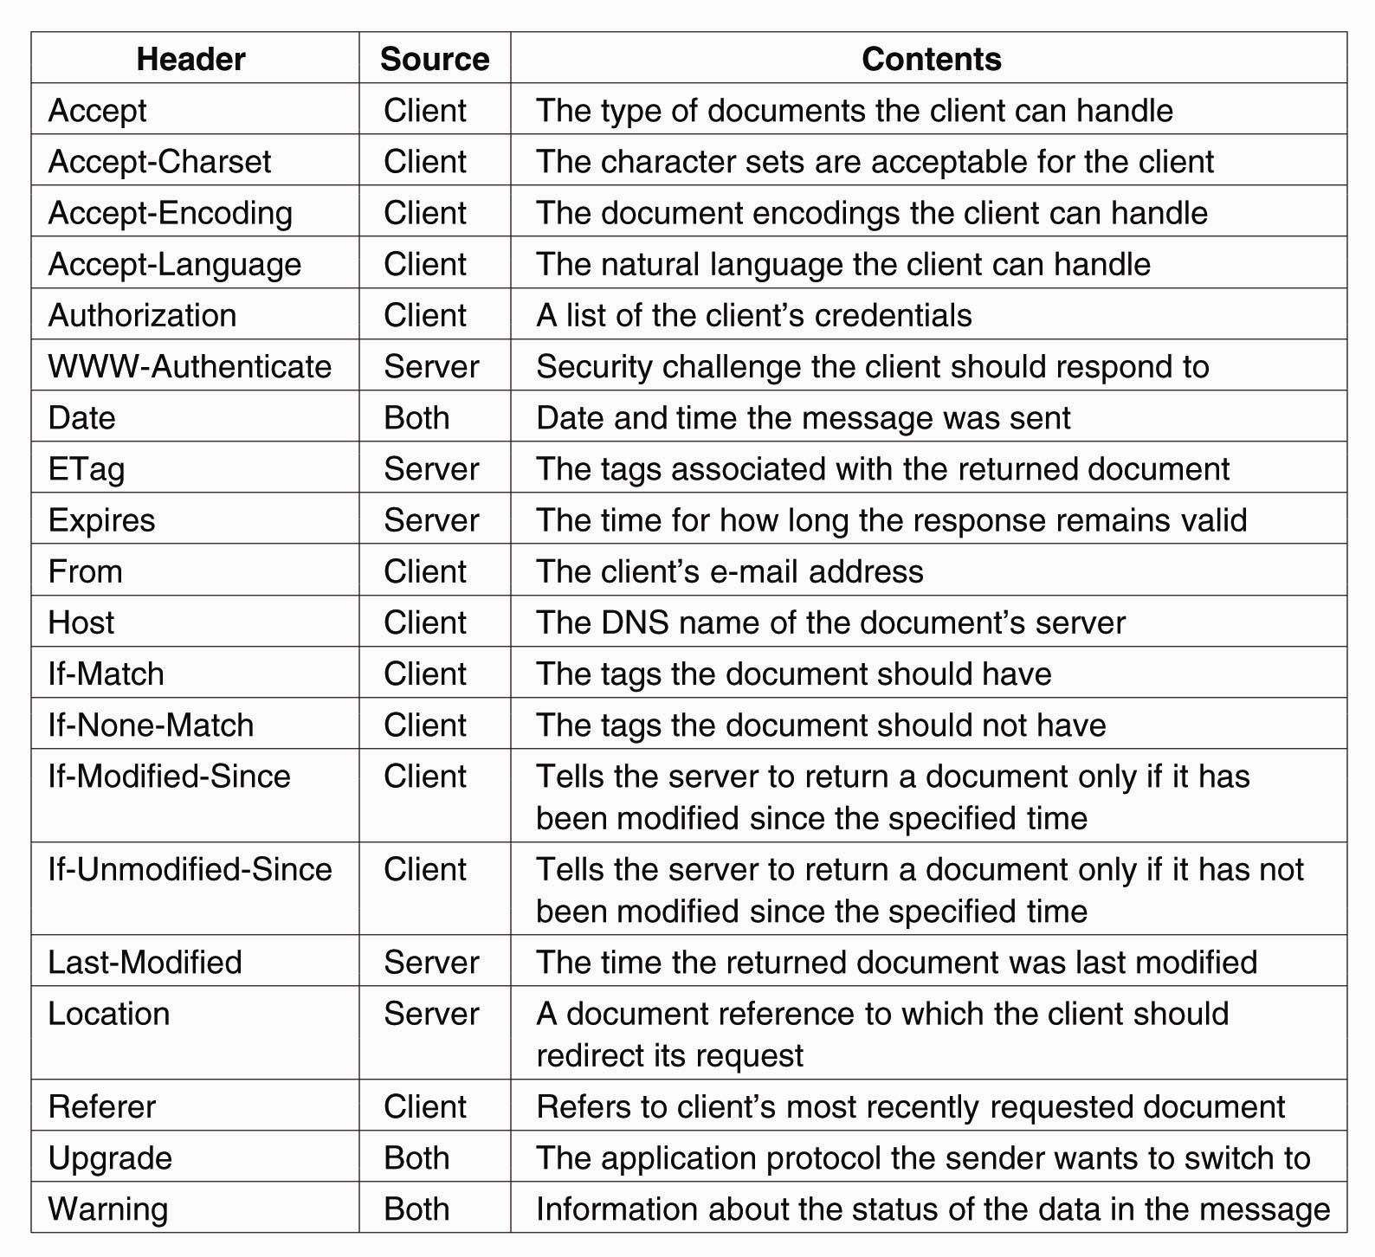
HTTP Messages (3)
Figure 12-13. Some HTTP message headers.

Slide 26
HTTP Messages (4)
Figure 12-13. Some HTTP message headers.

Slide 27
Simple Object Access Protocol
The standard for communicating with web services
Communications are implemented through HTTP
Messages are largely based on XML

Slide 28
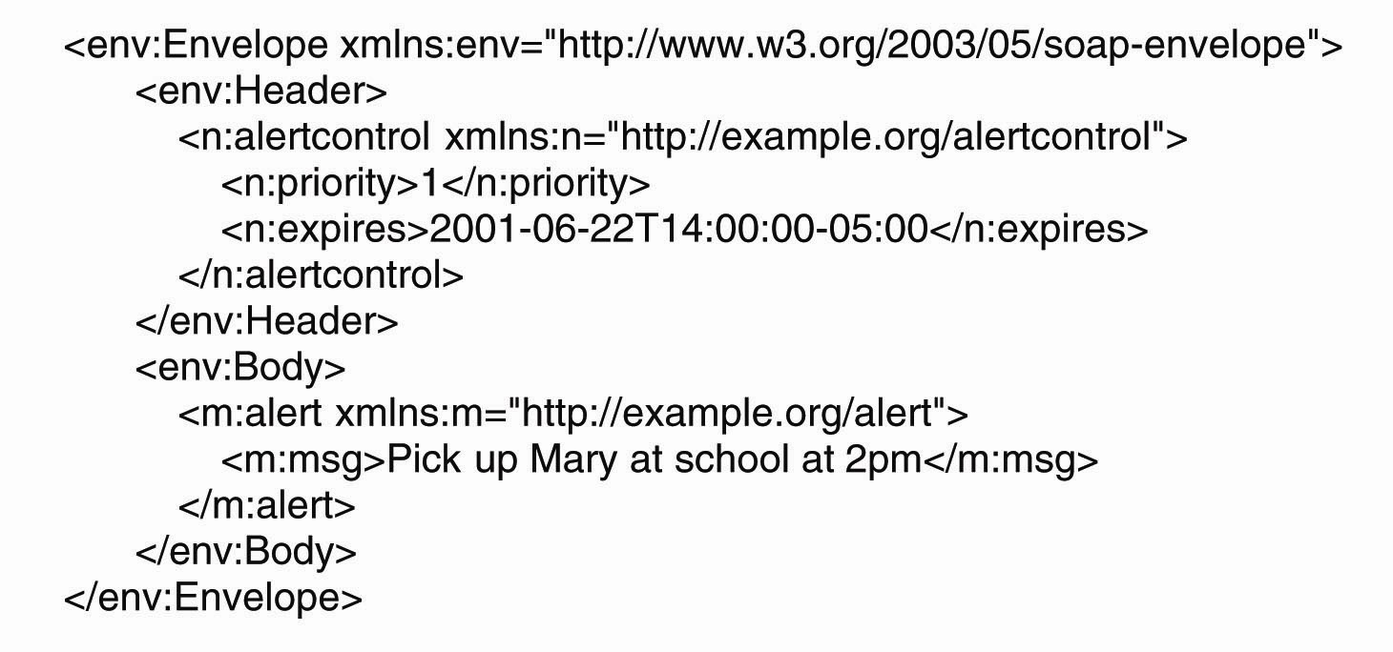
Simple Object Access Protocol
Figure 12-14. An example of an XML-based SOAP message.

Slide 29
Naming (1)
Uniform Resource Identifier (URI): Names used to refer to documents
Uniform Resource Locator (URL): A URI that identifies a document
Location-dependent reference to a document
Contain information on how and where to access a document
http, ftp, telnet – part of URL
Uniform Resource Name (URN): A true identifier of a document.
Globally unique
Location independent
Persistent

Slide 30
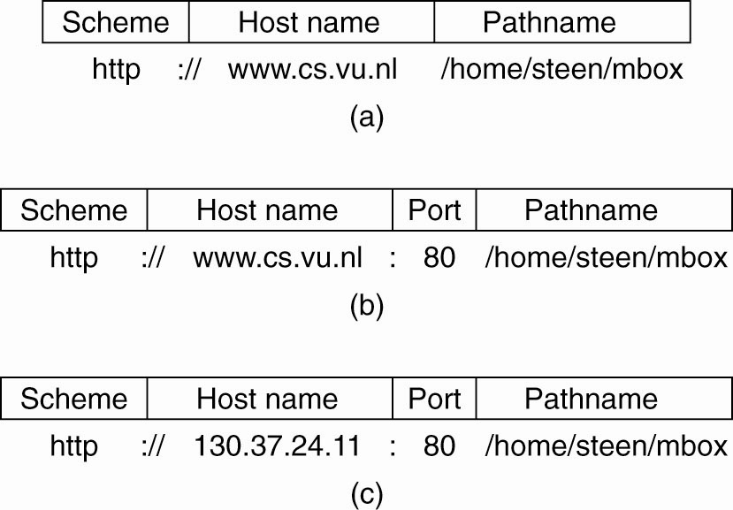
Naming (2)
Figure 12-15. Often-used structures for URLs. (a) Using only a DNS name. (b) Combining a DNS name with a port number. (c) Combining an IP address with a port number.

Slide 31
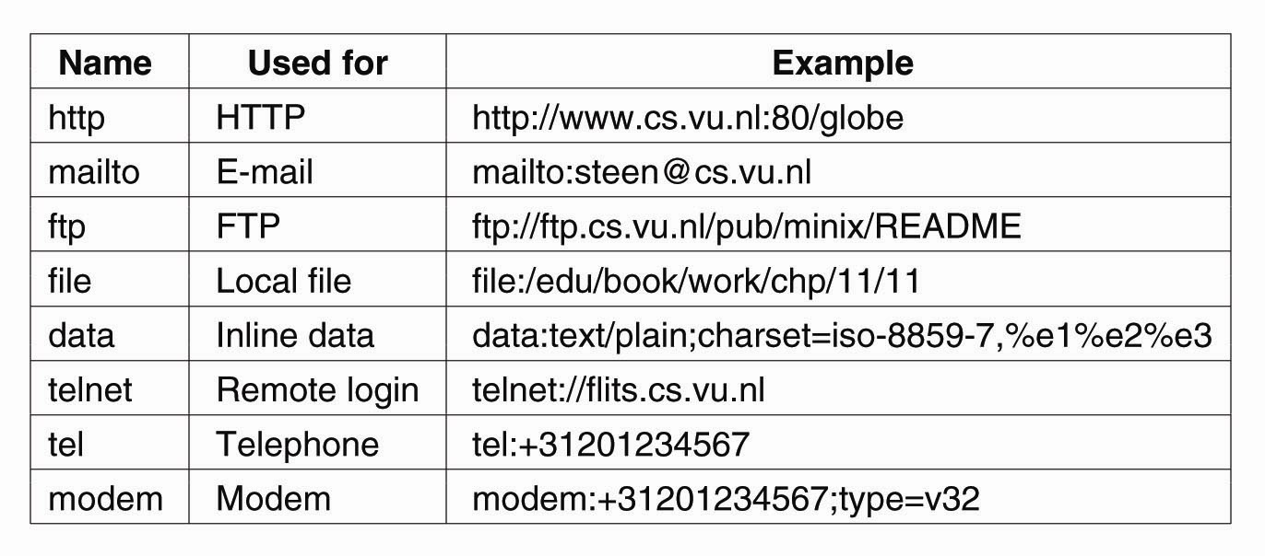
Naming (3)
Figure 12-16. Examples of URIs.

Slide 32
Synchronisation
Not much of an issue
Strict client-server organisation. No inter-client or inter-server exchanges
A read mostly system
Updates are done by single person/entity
No write-write conflicts.

Slide 33
Consistency and Replication
Access to web documents should meet stringent performance and availability requirements
To achieve this
Caching web content
Web proxy caching
Replicating web content
Old systems – supporting static content
New requirements – support dynamic content

Slide 34
Web proxy caching
Occurs at two locations
Client: Browsers have a caching facility. Configurable
Web proxy at client side. Can implement a shared cache.
Hierarchical caches
Country/regional level
Reduce network traffic
May cause latency (compared to non-hierarchical caches)
Cooperative caching / distributed caching
In case of a hit, neighbouring ones are consulted
Serves smaller number of clients
Usually on the same LAN

Slide 35
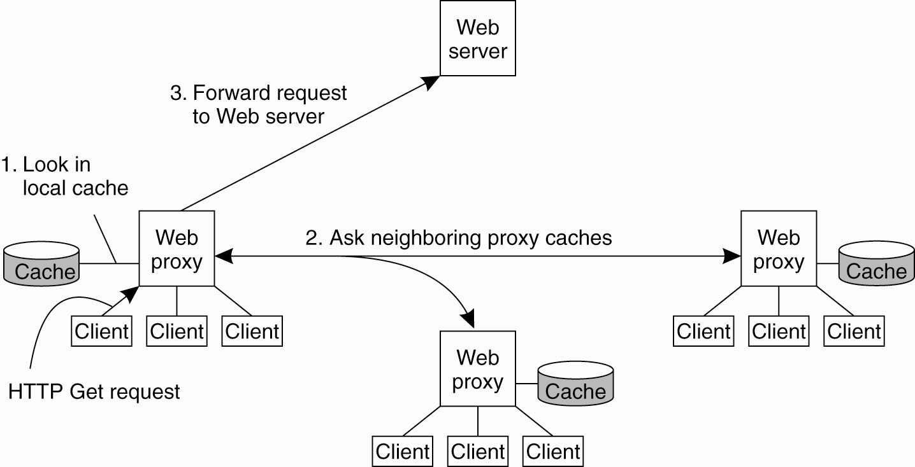
Web Proxy Caching
Figure 12-17. The principle of cooperative caching.

Slide 36
Web Proxy Caching
Cooperative caching
Access server at each request with If-Modified-Since request header – a pull-based protocol
Performance concerns
Squid web proxy
Assigns an expiration time
$T_{expire}= α(T_{cached}$- $T_{last−modified}$) +${ T}_{cached}$
$α=0.2 (experimental finding)$
Web proxy caching is for static documents

Slide 37
Replication of Web Hosting Systems
Web sites
Maintaining the content
Making sure that the site is easily and continuously accessible
Content Delivery Networks (CDN)
Act as web hosting service providing an infrastructure for distributing and replicating the web documents of multiole sites across the internet.
Because of the size the hosted documents should be automatically distributed and replicated – self managing system.
A large scale CDN can be organised as a feedback control loop

Slide 38
Replication of Web Hosting Systems
Three aspects of replication in web hosting system
Metric estimation
Adaptation triggering
Taking appropriate measures
Replica placement
Consistency enforcement
Client request routing

Slide 39
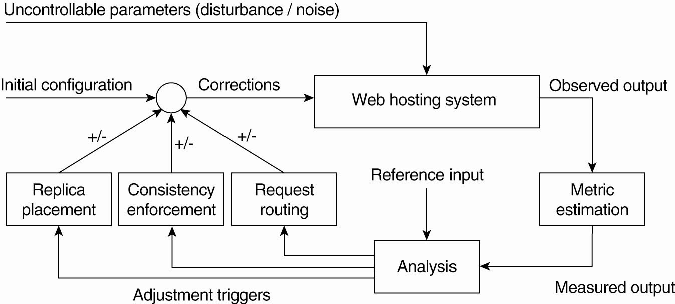
Replication for Web Hosting Systems
Figure 12-18. The general organization of a CDN as a feedback-control system (adapted from Sivasubramanian et al., 2004b).

Slide 40
Replication of Web Hosting Systems
Metric estimation
Latency metrics
E.g. time taken to fetch a document – difficult to estimate delasy between a client and a server
Measure available bandwidth between two nodes itself
Spatial metrics
Number of hops between two notes
Not practical in a multi route system
Network usage metrics
Consumed bandwidth – read, update, replicate
Consistency metrics – tight/loose consistency
Financial metrics – business case

Slide 41
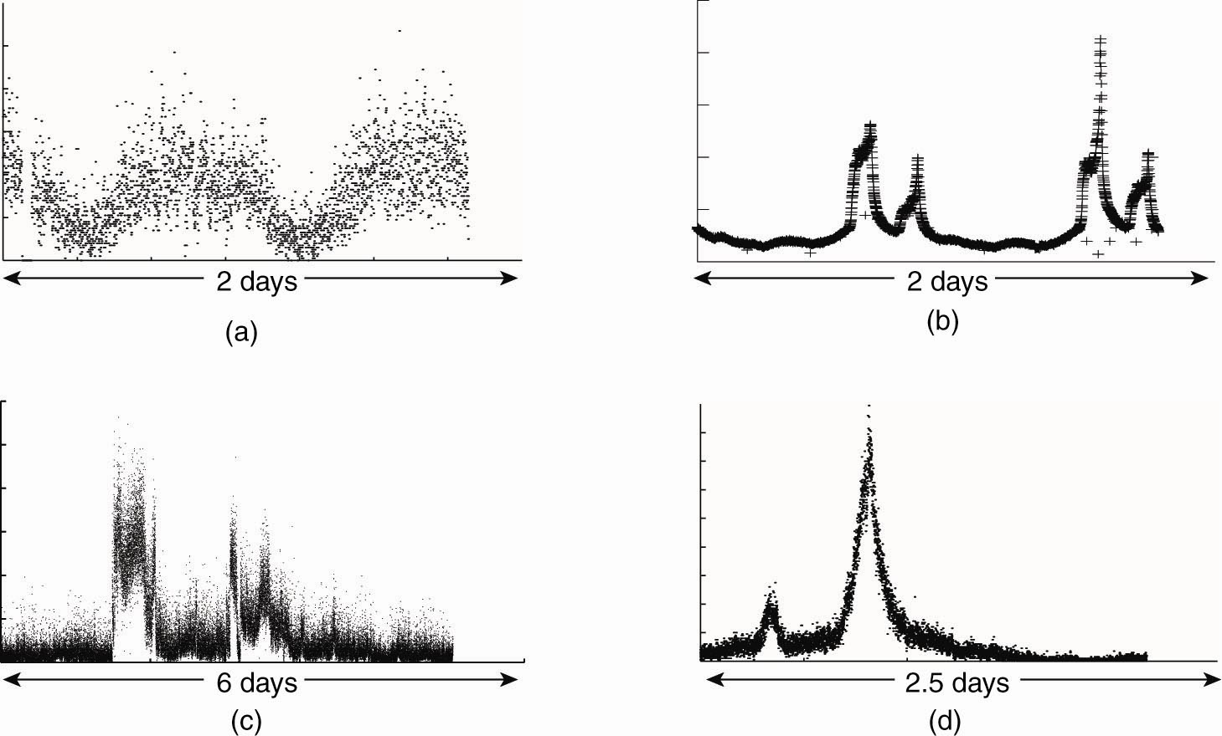
Adaptation Triggering
Figure 12-19. One normal and three different access patterns reflecting flash-crowd behavior (adapted from Baryshnikov et al., 2005).

Slide 42
Adjustment measures
Replica placement
Already discussed
Consistency enforcement
Already discussed
Client request routing/redirecting
HTML documents have embedded documents
Embedded documents hardly change
cache or replicate then fetch cached copies

Slide 43
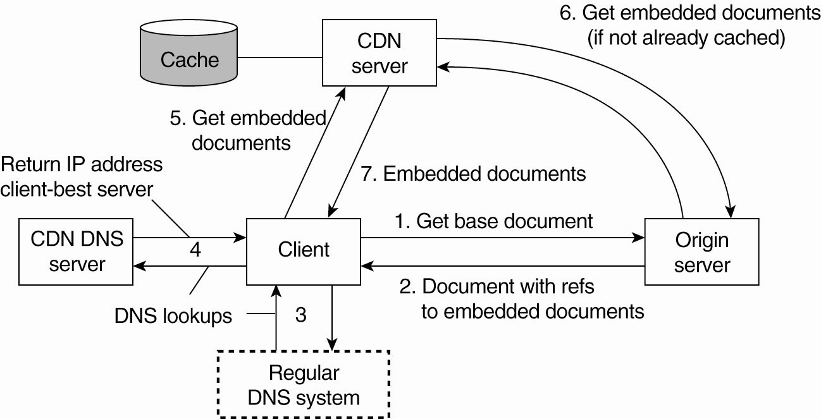
Adjustment Measures
Figure 12-20. The principal working of the Akamai CDN.

Slide 44
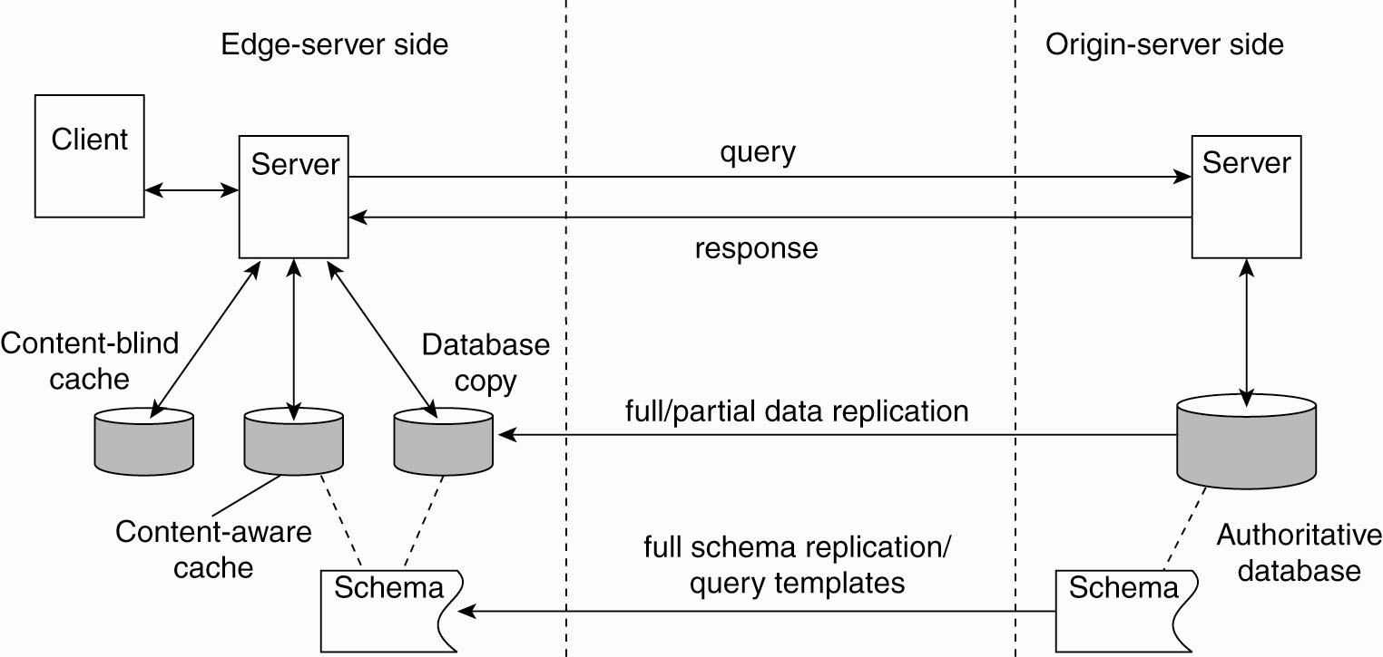
Replication of Web Applications (1)
Figure 12-21. Alternatives for caching and replication with Web applications.

Slide 45
Replication of Web Applications (2)
All updates are carried at origin server
Updates replicas and edge servers
To improve performance
Replicating data works when
Update ratio is low
Queries request extensive database search
Read/update ratio is important in improving performance when replicating
Complex database queries – full replication / single table - partial replication
Context-aware caches
$cost=\sum_{i=1}^{n}{w_{n}m_{n}}$, (weight x performance metric)

Slide 46
Fault tolerance
Client caching
Server replication
High availability provided through redundancy
No new/special techniques employed

Slide 47
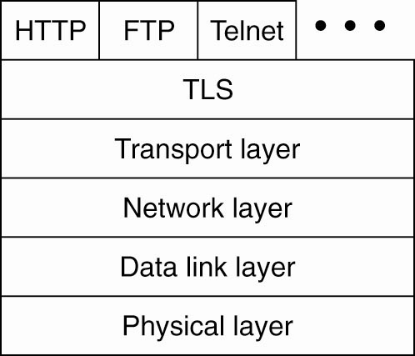
Security (1)
Figure 12-22. The position of TLS in the Internet protocol stack.

Slide 48
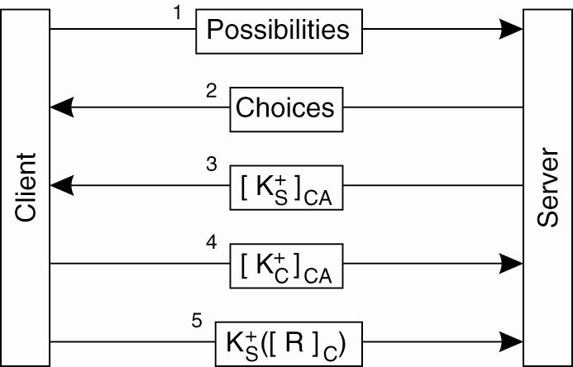
Security (2)
Figure 12-23. TLS with mutual authentication.

Slide 49
Summary
Distributed web-based systems
Architecture
Processes
Communication
Naming
Synchronization
Consistency and Replication
Fault Tolerance

Slide 50
Next Lecture
Distributed Coordination-based Systems
Architecture
Processes
Communication
Naming
Synchronization
Consistency and Replication
Fault Tolerance

